Slide 1

FLIGHT PRICE PREDICTION
By:
Akshaykumar B Torangatti

Slide 2
Introduction
Nowadays, the number of people using flights has increased significantly.
Anyone who has booked a flight ticket knows how unexpectedly the prices vary.
Flight price prediction is a challenging task since the factors involved in pricing dynamically change over time and make the price fluctuate.
The cheapest available ticket on a given flight gets more and less
expensive over time.
Flight ticket data is not well organized and ready for direct analysis, collecting and processing those data always requires a great deal of effort.
Features are extracted from the collected data to apply
Machine Learning (ML) models. We use the machine learning
regression methods to predict the prices at the given time.

Slide 3
WorkFlow
Define the problem statement, Objective, Targets, Expected Improvement appropriately.
Collect the data, the more and better the data, better is Analysis.
Exploratory Data Analysis, check for the information, check for null values, different datatypes available, dealing with missing values if any, Check for outliers, Checking the statistical overview of the data.
Understand the relationship between the attributes, apply the visualization techniques to draw the relationship and what inferences are they making.
Note down the observations based on the visualization
graphs we have created.
Write down the detailed data analysis and Conclusion.

Slide 4
OBJECTIVES
To scrape the data from different flights from different websites (yatra.com, skyscanner.com, official websites of airlines, etc).
Columns are airline name, date of journey, source, destination, route, departure time, arrival time, duration, total stops and the target variable price.
To find the if airfares change frequently? Do they move in small increments or in large jumps? Do they tend to go up or down over time?
To find what is the best time to buy so that the consumer can save the most by taking the least risk?
TO check if price increase as we get near to departure date? Is Indigo cheaper than Jet Airways? Are morning flights expensive?

Slide 5
FEATURES
Airline Name
Departure Date
Departure Month
Arrival Time
Departure Time
Source
Destination
Duration
Total Stops
Price

Slide 6
What is the data about ? What it represents ?
The flight ticket buying system is to purchase a ticket many days prior to flight take-off to stay away from the effect of the most extreme charge.
Someone who purchase flight tickets frequently would be able to predict the right time to procure a ticket to obtain the best deal. Many airlines change ticket prices for their revenue management.
I have scraped the data from yatra.com website using Selenium web driver and stored it into ‘Flight details.csv’ file.
This file consist of 5623 rows and 10 columns. All the attributes are categorical except departure date, departure month.

Slide 7
Mathematical/ Analytical Modelling of the Problem
We are going to estimate the minimum Flight price data for a specific air route using the data which has been collected including the features like departure time, arrival time and airways over a specific period.
Features are extracted from the collected data to apply Machine Learning (ML) models. We use the machine learning regression methods to predict the prices at the given time.
I have chosen 5 regression machine learning algorithms (Linear Regression, Random Forest, Gradient Boosting, Decision Tree, XGBoosting ) which is suitable for the pre-processed and cleaned data to train and test the dataset

Slide 8
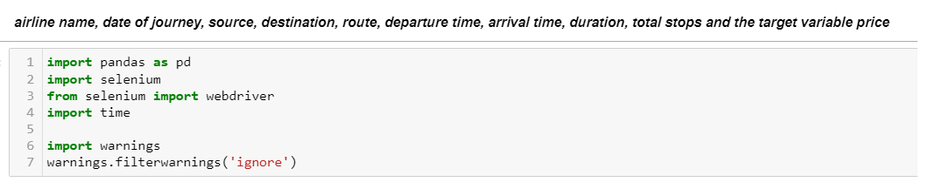
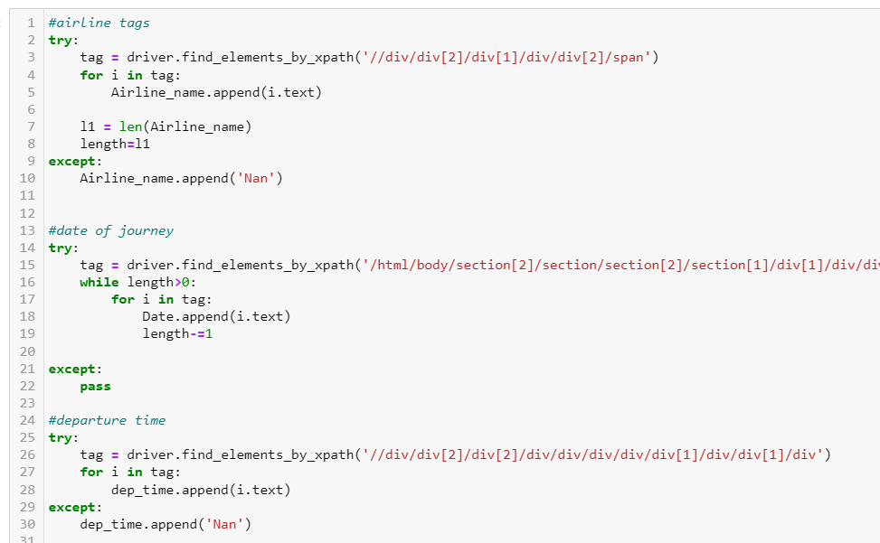
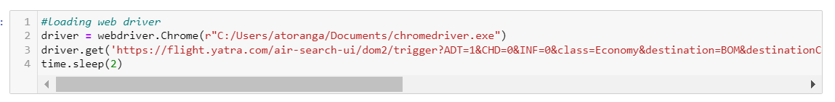
Data Collection
Data is collected by scraping the online websites and scraped different attributes which are helpful in predicting the flight price.

Slide 9
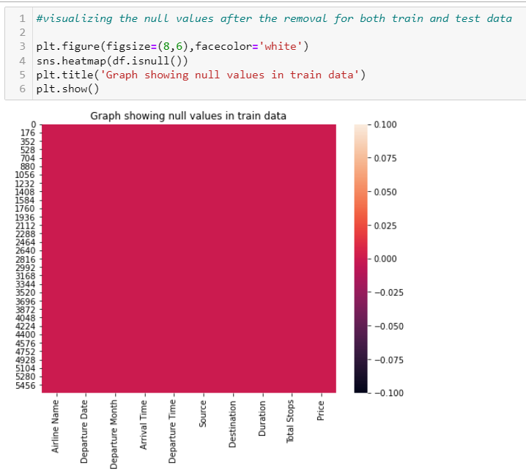
Data Analysis
All the gathered information required a great deal of work, We will clean and organize the dataset before feeding it to machine learning models.
We are using heatmap to check if there are null values.

Slide 10
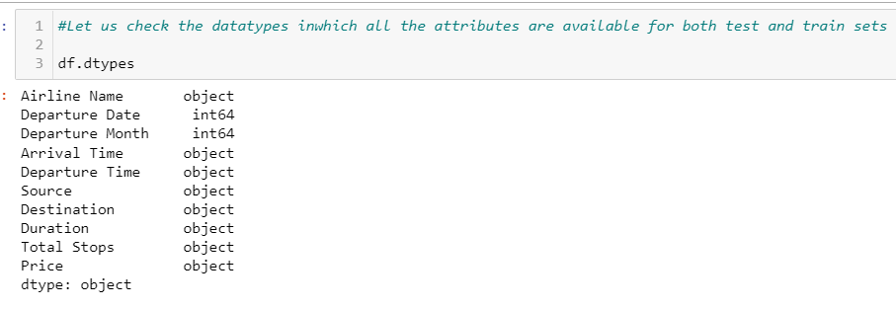
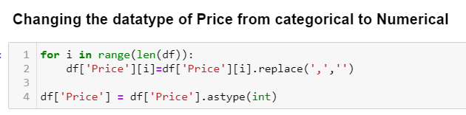
Data Preprocessing
We will check the datatypes of all attributes.

Slide 11
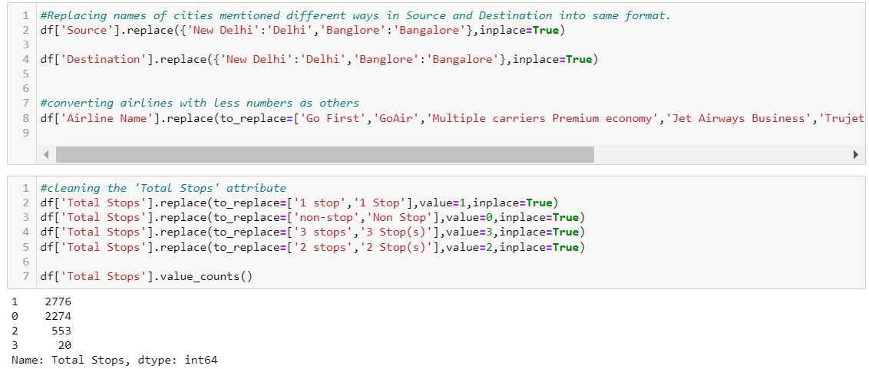
Data Pre-processing
As Jet Airways Business, Go Air, Go First, Vistara Premium Economy, Multiple carriers’ Premium economy, Trujet has very less flights we need to take care of this data.
Sources have same locations but mentioned in different ways, we changed the format.
Destination has same locations but mentioned in different ways, we corrected the format.
Total number of stops have the information but mentioned in different ways we have changed the format.

Slide 12
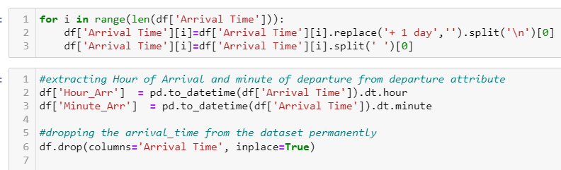
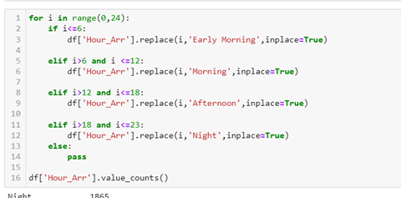
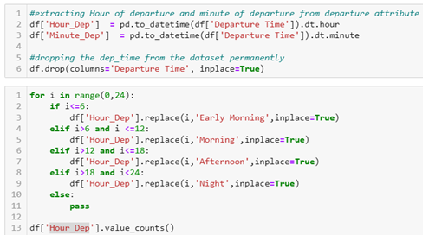
Data Pre-processing
Based on the hours we split the data into early morning flights, morning flights or evening/Night flights.

Slide 13
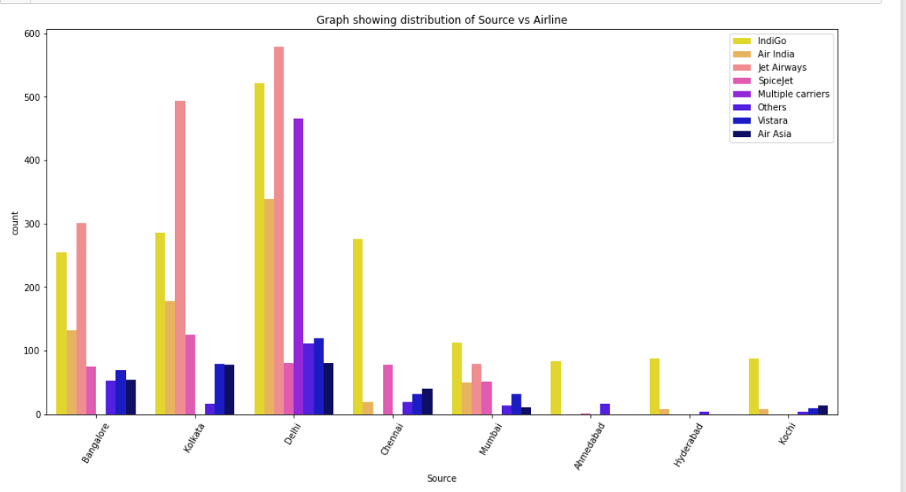
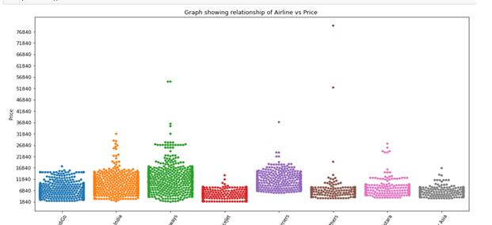
Data Pre-processing
Indigo flights and Jet Airways constitute nearly 50% of total flights compared to other flights used.
The hospitality of the flight, pricing ranges may be considered for this high number of usages.

Slide 14
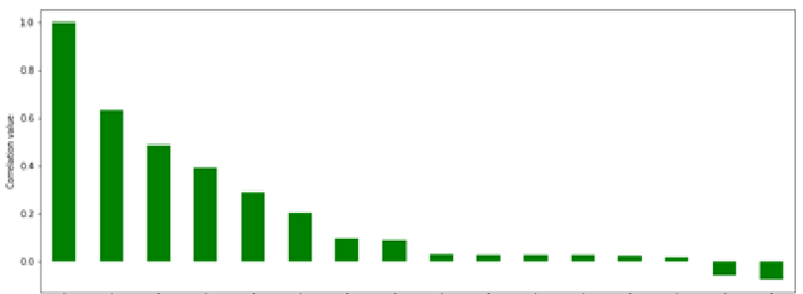
Data Pre-processing
The Correlation matrix is a data analysis representation that is used to summarize data to understand the relationship between various different variables of the given dataset.
We can see there are peaks formed in all the 4 months of observations marked in different colours. All the spikes seen are due to weekends (saturdays n sundays). The increase in price of tickets is about 10% of the regular price range.

Slide 15
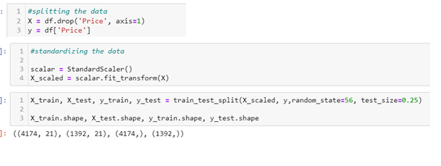
Data Pre-processing
We will create dummy columns for Airline, Source, Destination columns
We have drop the unnecessary columns, If the unnecessary
We will split the DataFrame into train and test data and train our machine learning model using training dataset.

Slide 16
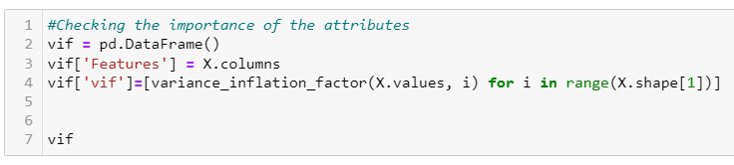
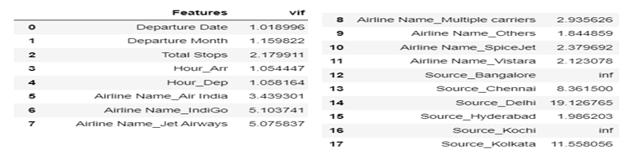
Data Pre-processing
Variance inflation factor (VIF) is a measure of the amount of multicollinearity in a set of multiple regression variables.

Slide 17
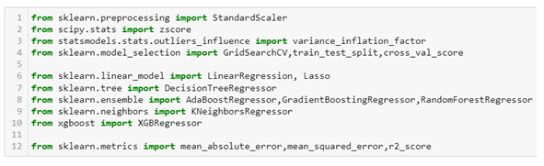
Model Building
We are using regression based algorithms to build the model, train and test the data which we have preprocessed and prepared in Exploratory Data Analysis part.
We use below libraries in preprocessing, model building, model selection and evaluating the model.

Slide 18
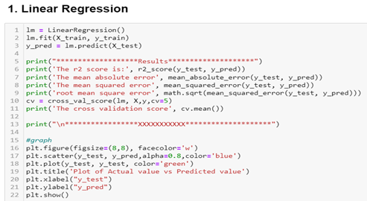
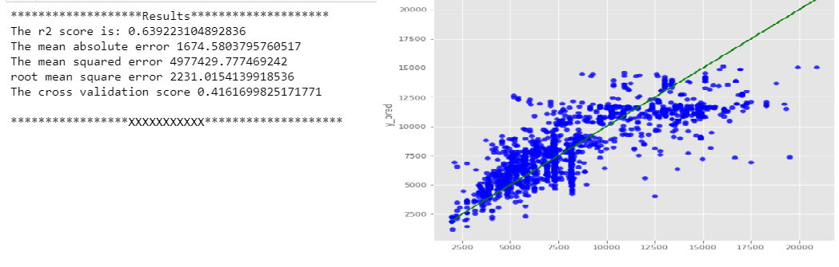
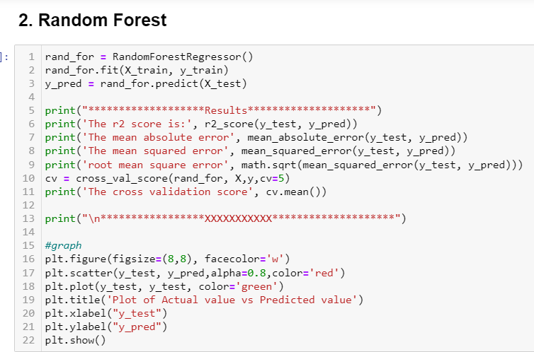
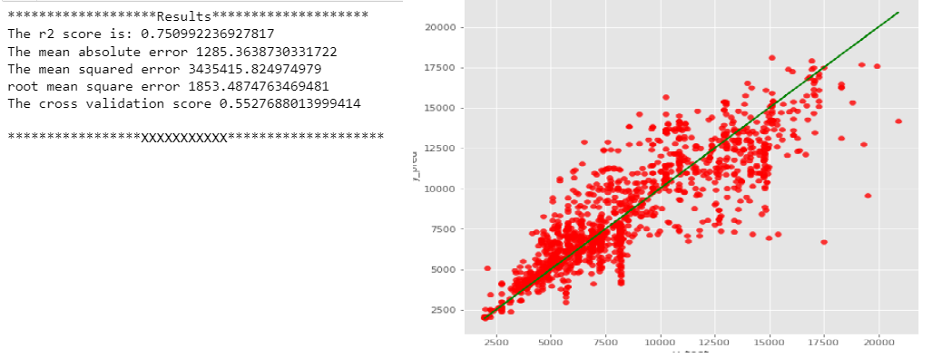
Model Building

Slide 19
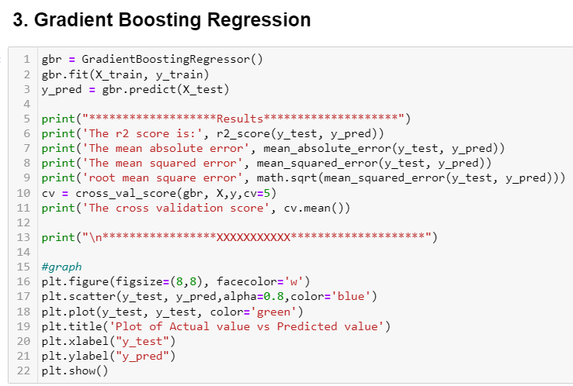
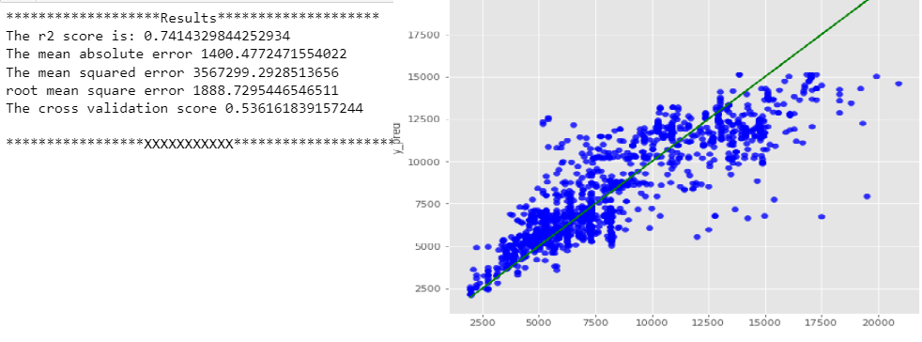
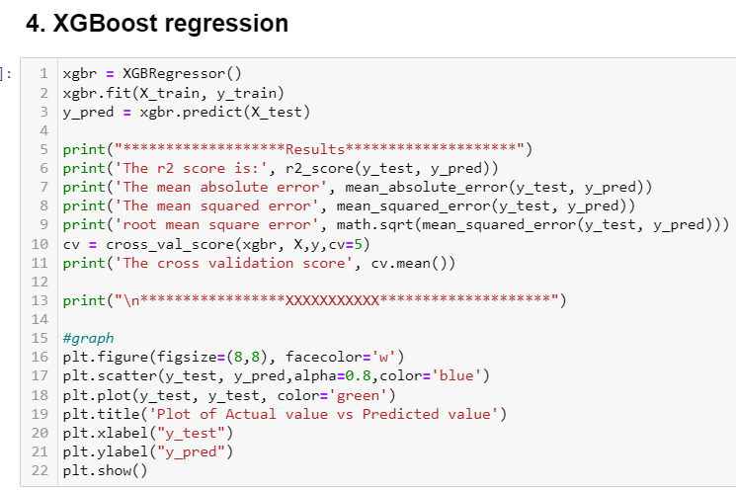
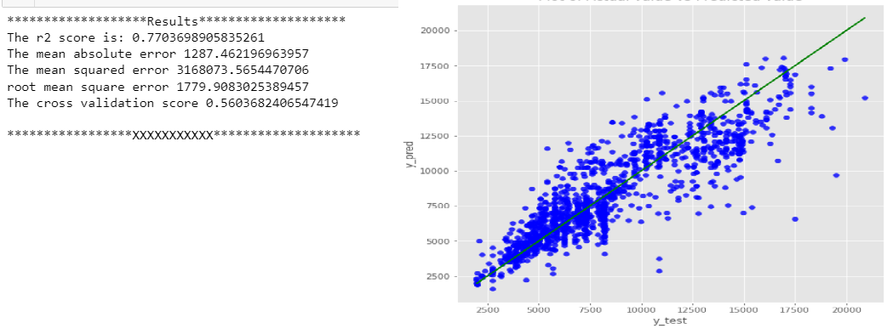
Model Building

Slide 20
Conclusion
Key Findings and Conclusions of the Study
To evaluate the conventional algorithm, a dataset is built for various routes in India and studied a trend of price variation for the period of limited days.
Machine Learning algorithms are applied on the dataset to predict the dynamic fare of flights. This gives the predicted values of flight fare to get a flight ticket at minimum cost.
Data is collected from the websites which sell the flight tickets so only limited information can be accessed.
The values of R-squared obtained from the algorithm give the accuracy of the model

Slide 21
Conclusion
Learning Outcomes of the Study in respect of Data Science
This project has demonstrated the importance of having large dataset for training and testing the machine learning model.
Through data cleaning we were able to remove unnecessary columns and outliers from our dataset due to which our model would have suffered from overfitting or underfitting.
Through different powerful tools of visualization, we were able to analyse and interpret different hidden insights about the data.
Build Models, since it was a supervised regression problem, I built 5 models to evaluate performance of each of them: a. Linear Regression b. Random Forest c. Decision Tree d. XGboost regression e. Gradient Boosting.

Slide 22
Conclusion
Limitations of this work and Scope for Future Work
In the future, if more data could be accessed such as the current an availability of seats, the predicted results will be more accurate.
One can focus on collection of real time customer-oriented data which can be useful for EDA. And more inference can be provided based on the analysis.

Slide 23
Thank You

